Slide 1
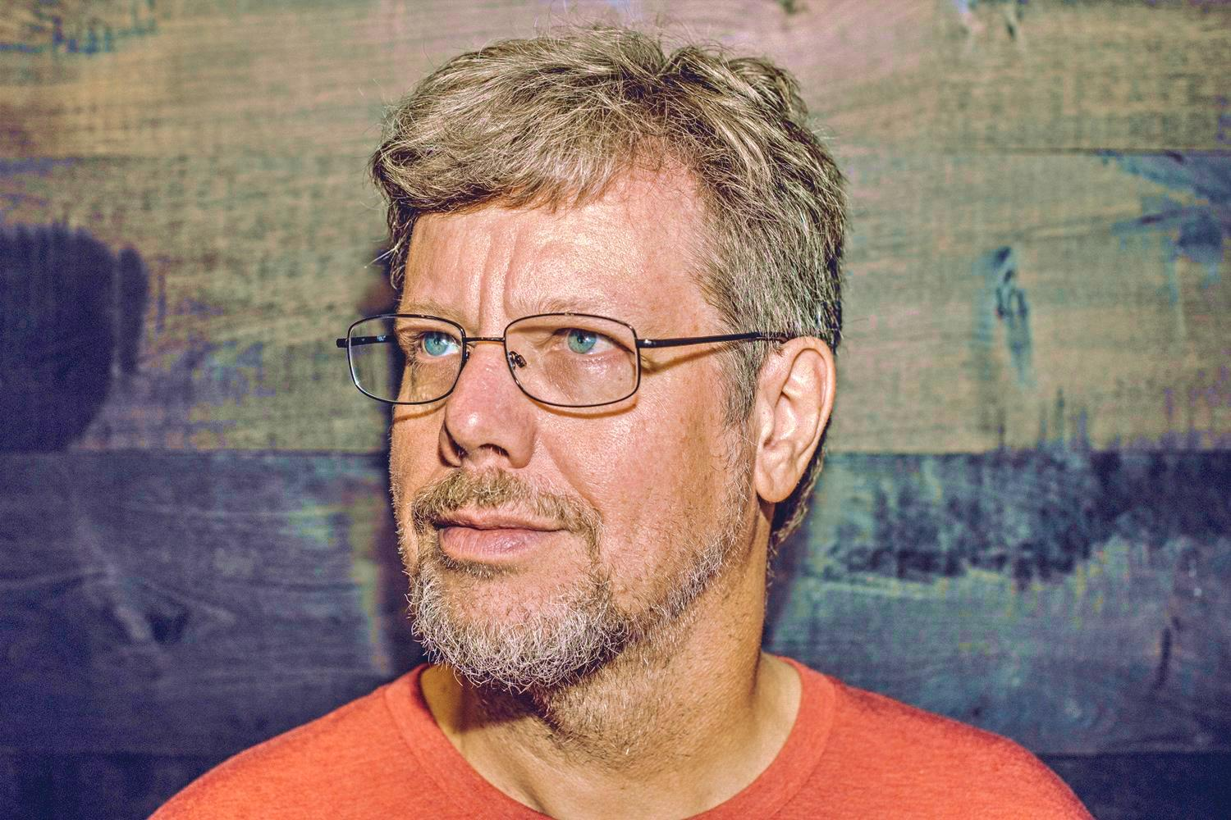
Python, Past Present and Future
Jaeden.Leo.Euan.Hassan

Slide 2
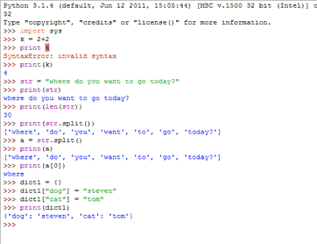
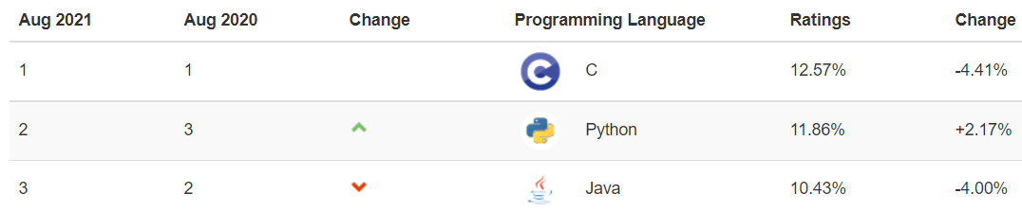
What is python?
Python is a object oriented human readable language.
Second most popular language in the world (According to the Tiobe Index)
Capable in many fields from data science to game development
Runs on any platform
Python is mainly interpreted making it easy to learn and debug
Notes:
H

Slide 3
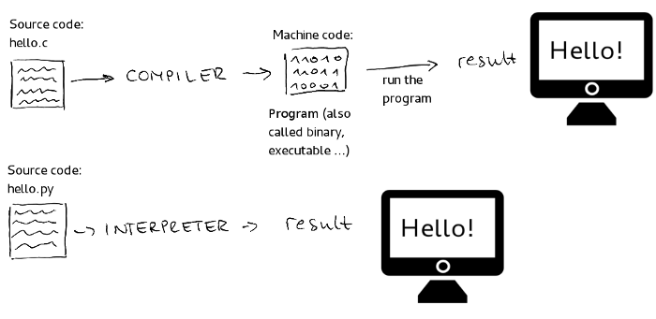
Difference between compiled and interpreted
Python is an interpreted language making the code be converted into machine code line by line as the program is being run. This is compared to another programming language C that is compiled making it required to be compiled then run separately.
Notes:
Leo

Slide 4
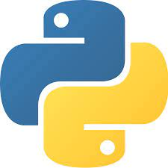
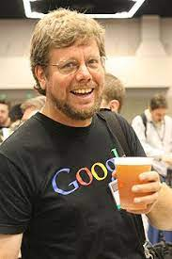
The start of Python
Released February 20th in 1991
By Guido van Rossum
First version was Python 0.9.0
Inspired by the ABC Language
Notes:
H
Fun fact: Python got its name from the sketch tv show, “Monty Python’s Flying Circus”.

Slide 5
A Quick History of Python
2008 ver. 3
Fixed fundamental design flaws
1991 ver. 0.9.0
First release
2021 - Now
2000 ver. 2
Added many new features
2020 ver. 3.9
Most recent stable release
Notes:
H

Slide 6



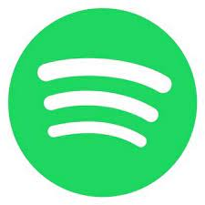


Where is it used?
Python is used everywhere! A large majority of the most popular websites, applications and companies use Python, like:
YouTube
Google
Spotify
Instagram
Reddit
NASA
Notes:
Euan

Slide 7

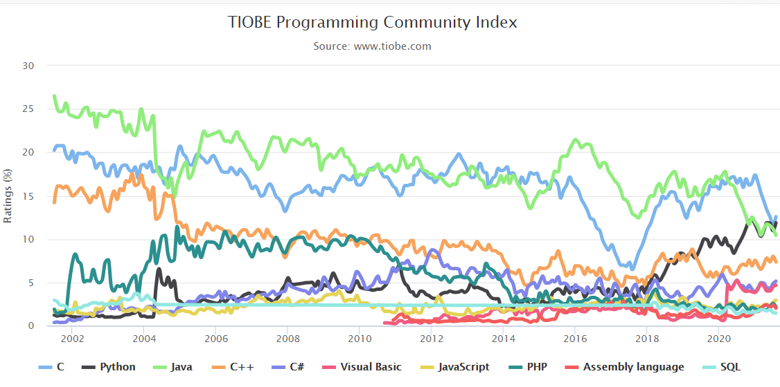
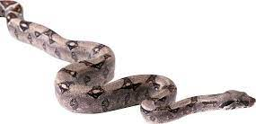
Benefits of Python?
Python is a very well known programming language, so what makes it popular? Python is:
Incredibly easy to learn
Code uses english and is easy to write/understand
A good skill to have for most jobs
Used by many companies
Quick to script and execute
Hundreds of different uses
Interpreted instead of compiled
Notes:
Euan

Slide 8
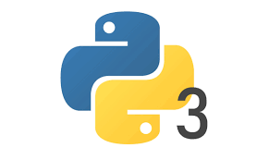
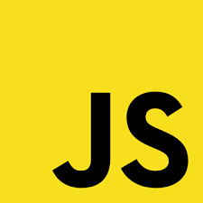
Python vs. Javascript
Python
Easy to learn
Runs on anything
More used for backend (api development)
Takes less time to develop
More popular
Javascript
Faster than Python
Good go-to language
Flexible
Mainly used for front end (browsers, mobile apps)
Upcoming backend possibilities (node)
Notes:
Node can be used to create js back ends

Slide 9
Future of Python?
Next ten years:
More popularity amongst beginning and advanced programmers
More commonplace as an essential skill required for jobs
Newer versions of Python (4)
Longterm:
Python may be updated and become more advanced/accessible
Programming becomes required for jobs/taught in schools

Slide 10

Notes:
Leo

Slide 11
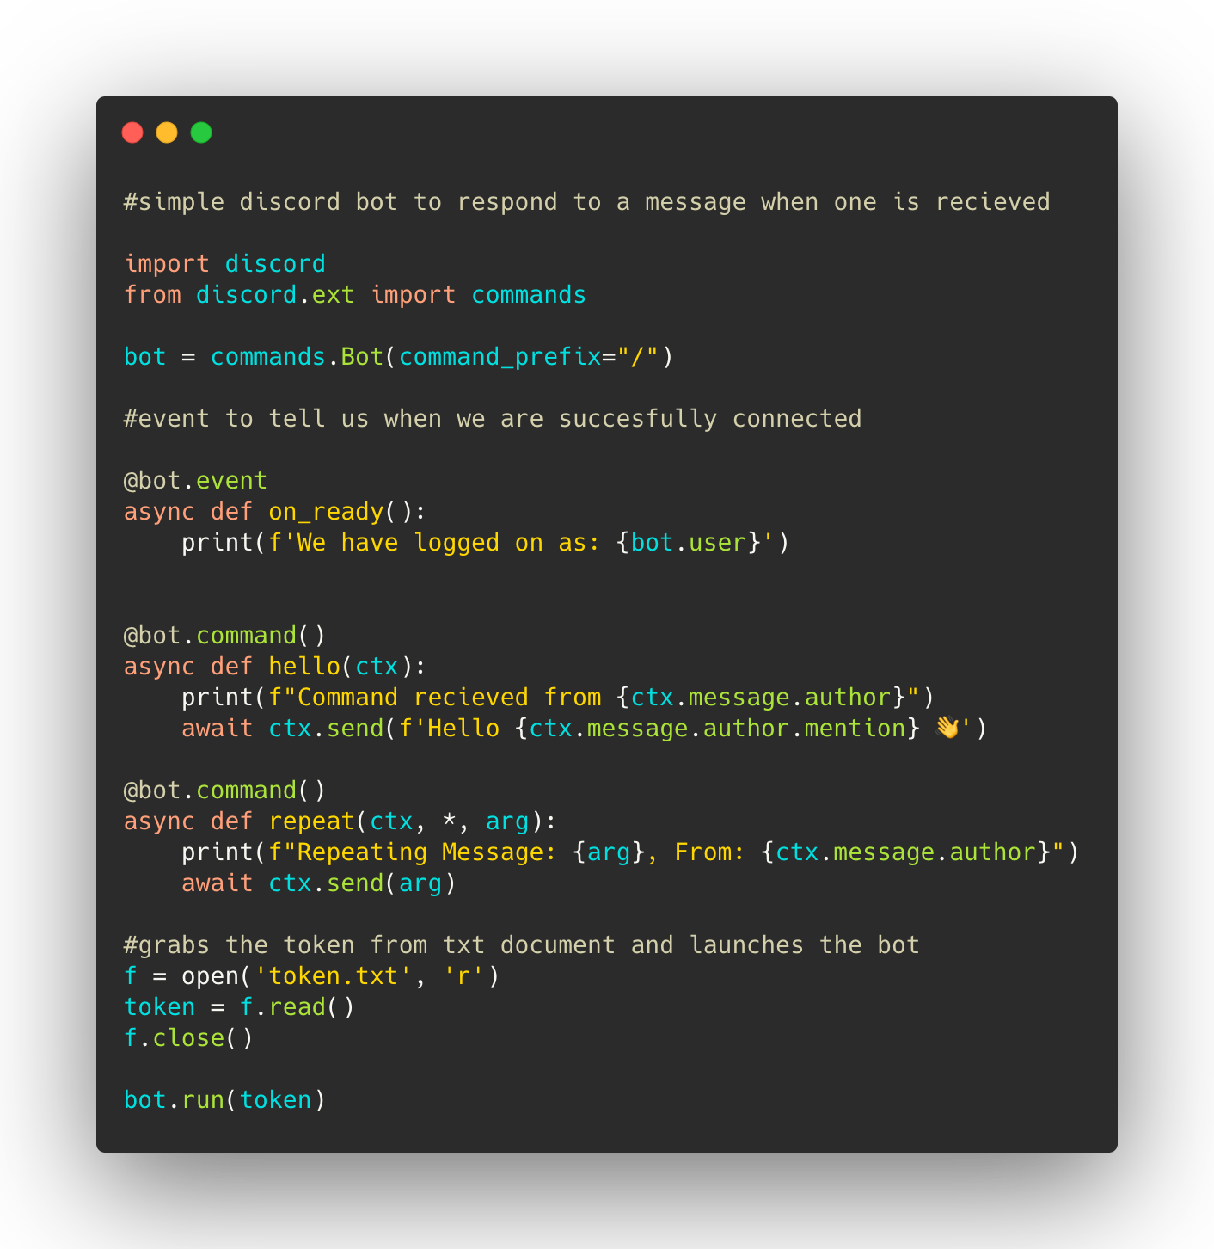
Demonstration

Slide 12
Resources
Python.org
Wikipedia - Python
Upgrad.com - Why is Python Popular?
bootcamp.berkely.edu - most in demand languages
Northeastern.edu - Most popular programming languages
Free Code Camp - Interpreted vs Compiled
https://www.javatpoint.com/which-is-better-java-or-python
DZone.com - Future of Python
Djangostars.com - Apps built with Python

